Slide 1

Cryptocurrency Analysis
2018
Alex garfias
Andrew Scott
Aritra ghosh
Brandon leal

Slide 2
Team Motivation for Crypto
Much of our motivation surrounding choosing crypto currency is because it’s a hot topic right now.
We wanted to know based on historical data if crypto currencies were a good option for long term investments?
Using historical data are crypto currencies a good choice to use to trade with?
Do currency changes correlate with each other?
We leveraged Bitcoin, LiteCoin, and Ethereum

Slide 3
Results High-level
Based off of 2018 historical data, crypto currencies do not make a good long term investment
However choosing to trade currencies can make for a profitable portfolio as you will see in the next few slides
Daily variances vary greatly
The high volatility of the cryptocurrency vs other investments markets drives investors away, although it has gained popularity in the last few years, investors seem very hesitant and do not consider it as a greatest investment option.

Slide 4
HISTORY & EVOLUTION
1998 – 2009 The pre-Bitcoin years to 2018
Although Bitcoin was the first established cryptocurrency, there had been previous attempts at creating online currencies, two examples of these were B-Money and Bit Gold, which were formulated but never fully developed.
In 2009, a paper called Bitcoin – A Peer to Peer Electronic Cash System was posted to a mailing list discussion on cryptography by Satoshi Nakamoto, whose real identity remains a mystery.
In 2010, Bitcoin is finally valued, then in 2011 rivals appear (Namecoin & Litecoin) which led to Bitcoin crash in 2013.
Ethereum appears in 2016 enabling the cryptocurrency known as Ether to facilitate blockchain-based smart contracts and apps.

Slide 5
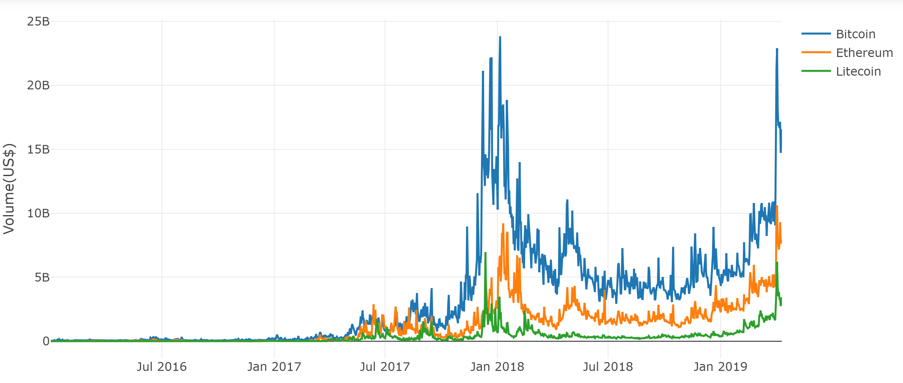
Volume Comparison
In 2017 cryptocurrency had a huge spyke in the market, but 2018 was bad. Among the top cryptos, the fell was (around -34%).
BTC fell by -73%, which actually correlates to its long term volatility.

Slide 6
Data Cleaning and Exploration
Initial data gathering proved to be more difficult than we anticipated, many sites wanted us to subscribe to gather historical data
Google has depreciated their finance API
Yahoo API is no longer updated, and has minimal documentation
Ultimately data was extracted from Yahoo, and QuantConnect
Data scrubbing was completed- gathering our data into dataframes, changing decimals to whole numbers, creating moving averages
Connecting to Twitter data proved to be a challenge
To evaluate data for trading Monte Carlo simulations were completed

Slide 7
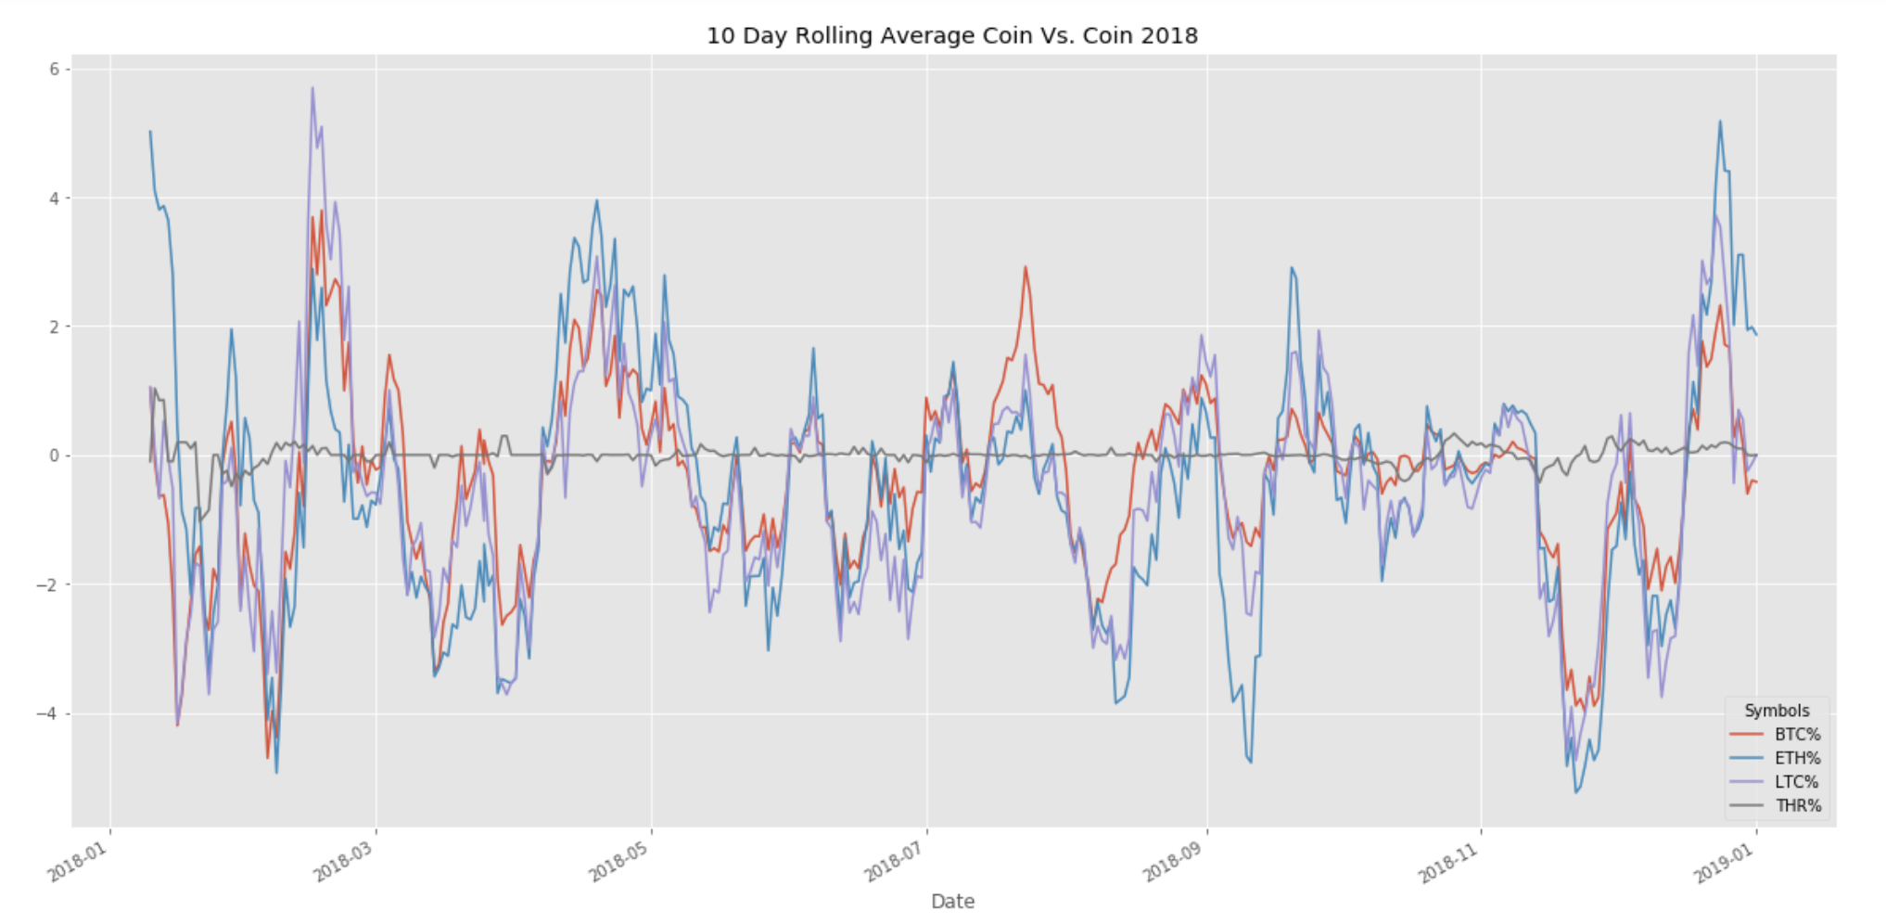
Coin vs. Coin Comparisons
What do the daily changes look like compared to the Dollar?
Mean % Change 2018
BTC% -3.395422e-01
ETH% -4.556945e-01
LTC% -5.310612e-01
Coin with the greatest variance?
LiteCoin- Nearly 30% up
And 25% down in a single day!
Is there a correlation between daily changes?
Coin vs. Coin P-Value = 0.2500
P-Value W/ Tether = 1.7157990391769624e-07

Slide 8
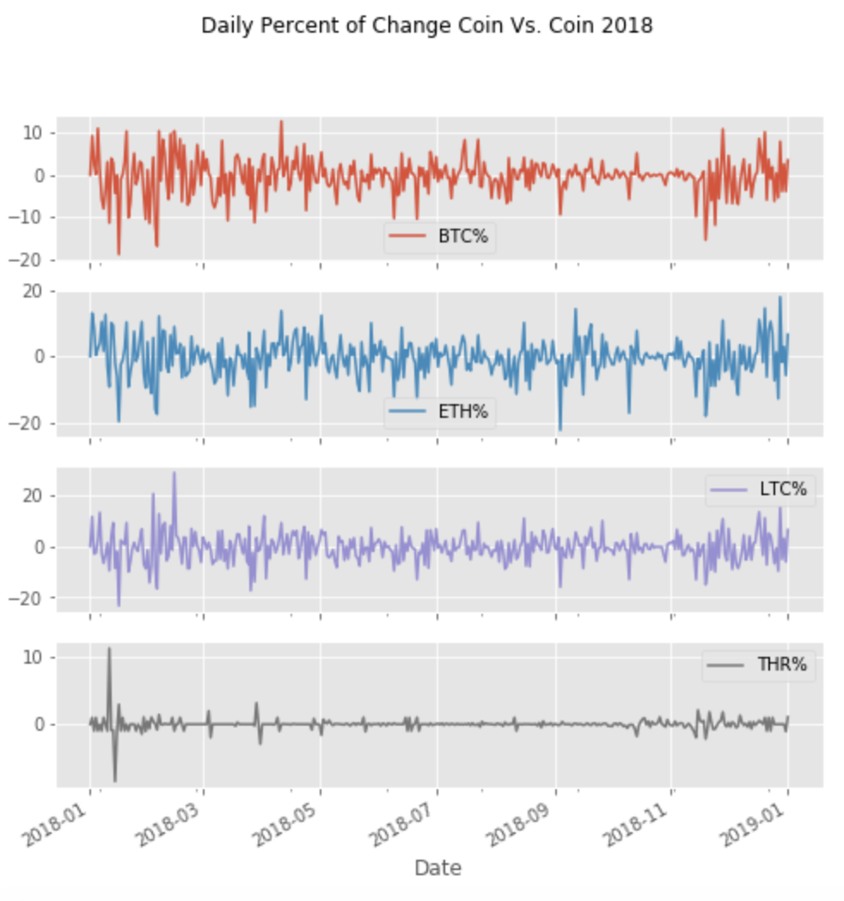
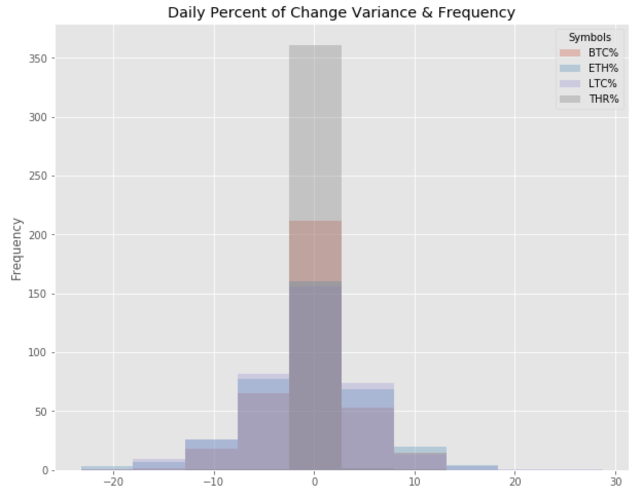
Coin vs. Coin Comparisons
Which coin has the most variance?
Wild daily variances observed from +30% to -25%
Note Tether (USD) stays very consistent with minimal change

Slide 9
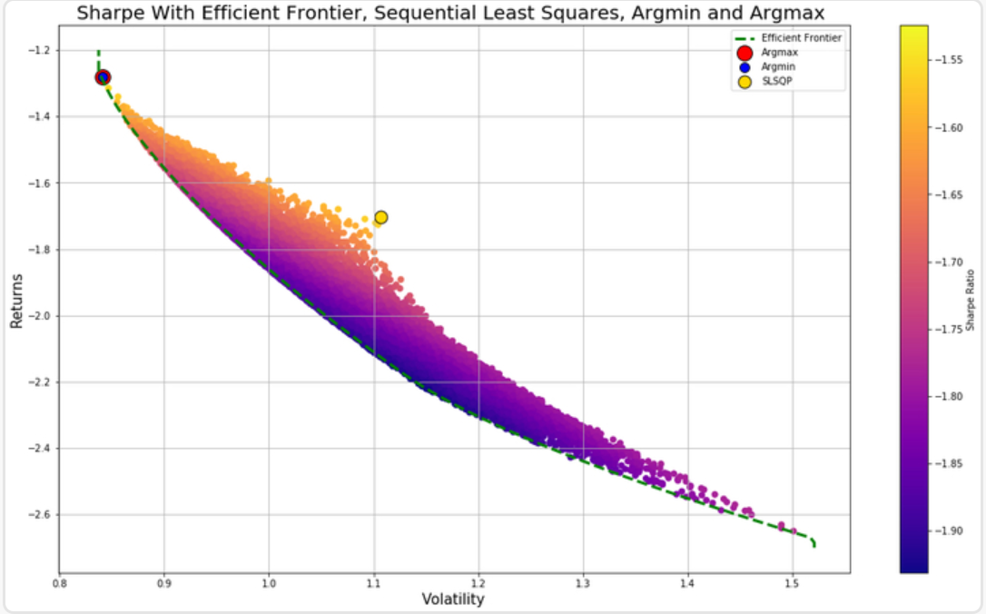
SHARP RATIO S&P vs CRYPTOS

Slide 10
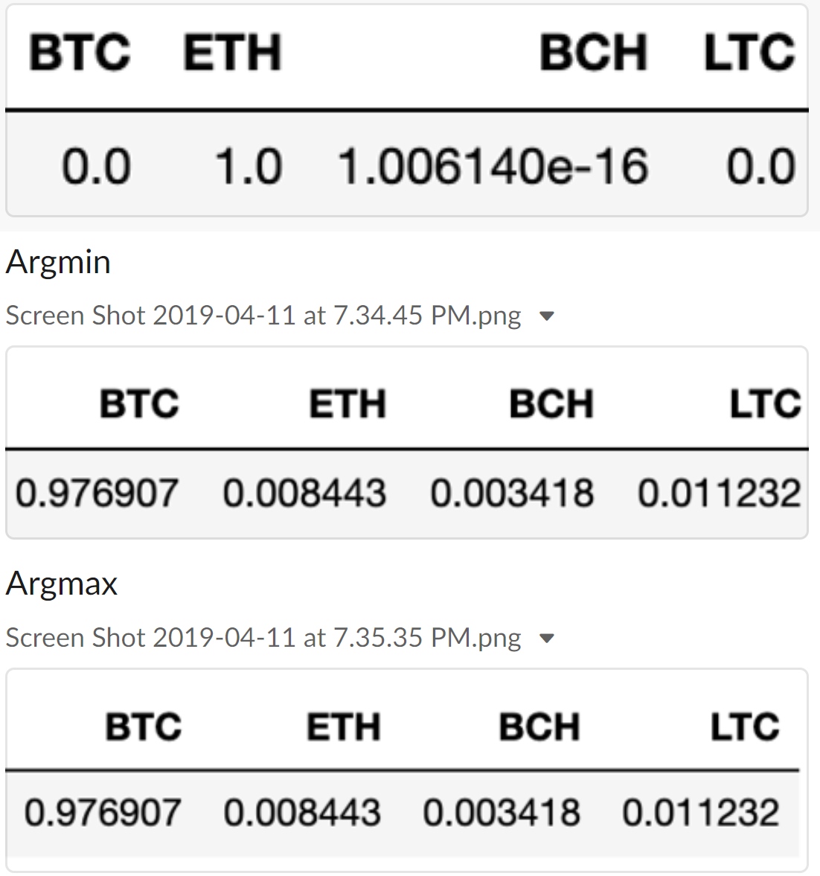

Brandon

Slide 11
Brandon
Pending

Slide 12
What is Cryptocurrency Hedging?
Hedging is a risk reduction strategy that typically involves taking an offsetting position on one’s primary asset, it provides insurance, reducing the potential for loss.
Hedgind Methods:
Although diversification is a common way to mitigate risk in the stock market, it looks somewhat different in the cryptocurrency market.
Most coins are very volatile and the market generally trends together day to day.
The best strategy for hedging against too much risk is to build the foundation of your portfolio on the most reputable coins, such as Bitcoin, Ethereum and Ripple which are the least volatile and could be decent hedges agains other riskier coins. It is important to maintain a healthy mix.
Another tip for hedging cryptocurrencies, is to make an account on an exchange that lets you hold money in fiat currency as well as cryptocurrency.
This makes it easy to transfer money in between and not get stuck in a bind if a major crash occurs.
This also allows you to quickly take advantage of optimal exchange rates and adjust the proportion of money you have invested.
You can also invest in Tether, a cryptocurrency that tracks its value with that of the U.S. dollar, and trade in and out of other coins that way.

Slide 13
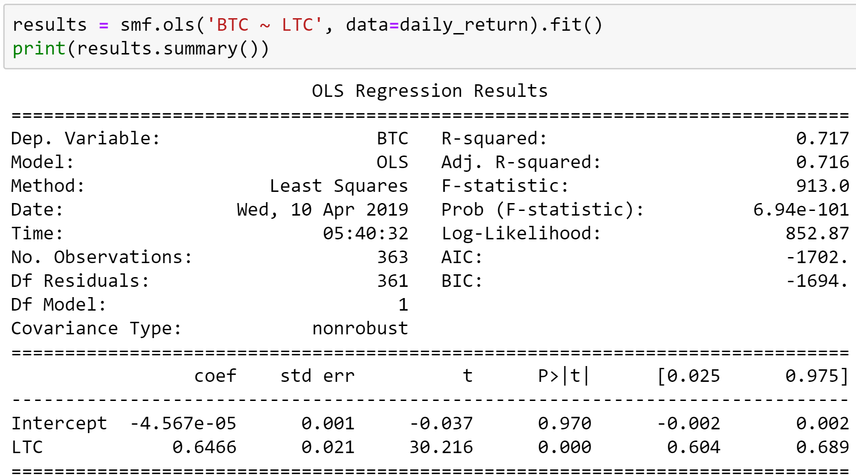
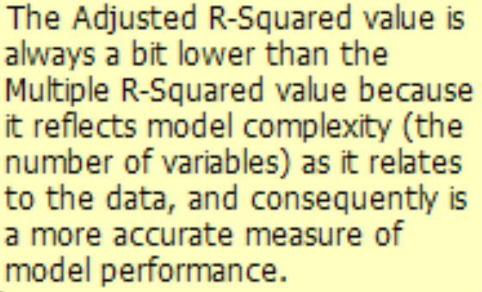
Cryptocurrency historic regression
To build a hedging chart, we first had to create a historic regression for 2018; the F-statistics and the prob (f-statistics) are measures of overall model statistical significance. The F-statistics are trustworthy only if the prob (f-statistic) is not significant.

Slide 14
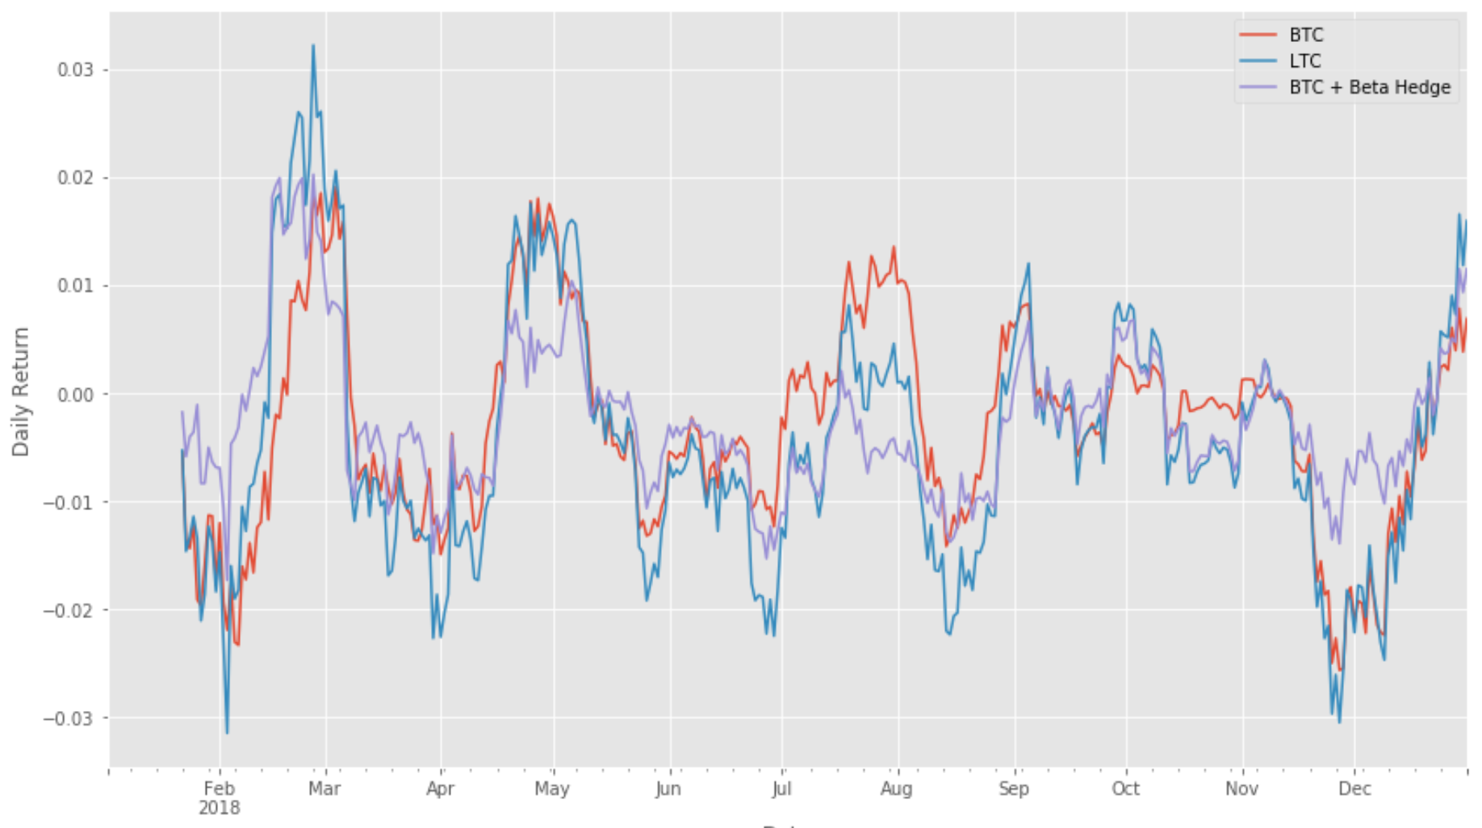
Cryptocurrency Hedging Chart
A good way to understand hedging is to think of Gap insurance; although, there is a difference -Gap insurance involves paying someone to bear the risk, while hedging involves making an investment to offset the risk.
This graph shows the hedging line to offset the risk on BTC only, and as you can see hedging really played a good role protecting the investment in rough times, thus avoid a greater loss.

Slide 15
Questions or Comments?

